Slide 1


Reinforcement Learning agents for Flexible Resource Allocation in Mobile Edge Computing
By Mark Towers
Supervisor: Professor Timothy Norman
Second examiner: Dr Nick Harris

Slide 2
Motivation
Mobile Edge Computing (MEC) is a developing paradigm (Mao et al., 2017) that provides users with the ability to run their tasks with greater proximity to them in the network.
This helps reducing latency, network congestion while providing better application performance than traditional Cloud Computing.
The technology is currently utilised in Disaster response, Smart cities, Internet of Things and more
However there are shortcomings in existing research for resource allocation within MEC. This is due to how each task’s resource usage is determined which can cause bottlenecks and limit the number of concurrent tasks that system can serve. (Fully explained in Chapter 1 and 3)

Slide 3
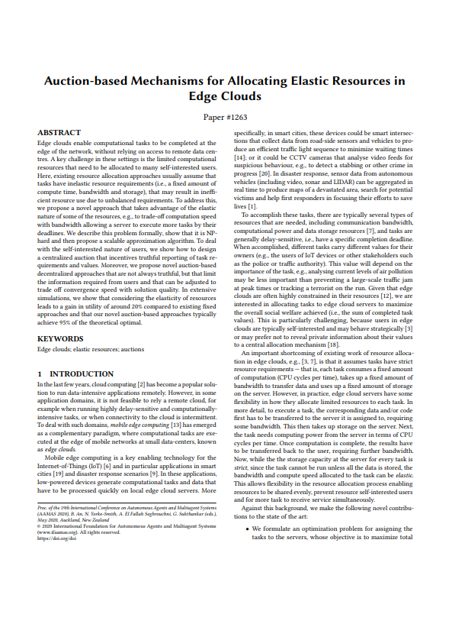

Static Flexible Resource Allocation
Therefore a novel resource allocation mechanism was proposed (Towers et al., 2020) to allow for significantly more flexibility in determining resource usage with the aim of reducing bottlenecks and increase the number of tasks that can run concurrently.
This work is Appendix A and B
The mechanism is based on the principle that the time taken for an operation to complete is generally proportional to the resources provided for the operation.

Slide 4
Online Flexible Resource Allocation
However these formulation were viewed to have flaws due to being static / one shot where in all tasks would be auctioned and resource allocated at the first time step. Requiring the system to process tasks in batches and prevented resource from being changed between batches.
These issues were solved through introducing time into the optimisation problem.
However this proposal causes all previous research to be incompatible with this modified Online Flexible resource allocation problem (Section 3.1).

Slide 5
Auctions
While the mathematically description of the optimisation problem presented doesn’t consider any auctions occurring. In real life servers are normally paid for the use of their resources through auctions.
Also for dealing with self-interested users who may misreport their resource requirements, auctions can limit this.
The Vickrey Auction (Vickrey, 1961) is selected over the alternative due to requiring a single round of bidding and for being Incentive Compatible (Section 3.2)

Slide 6
Auction and Resource Allocation Server agents
Due to the complexity of the problem to both efficient allocate resources and bid of auctioned tasks, Reinforcement Learning was utilised to learn these functions.
To train agents, this was done in several sections:
An environment was implemented to simulate an Online Flexible Resource Allocation MEC network. (Section 4.1)
With each server requiring two agents for the environment, an auction and resource allocation agent (Section 4.2)
A variety of agents are trained and evaluated (Section 4.3 and Section 5.2)
Algorithms: Dqn, Double Dqn, Dueling Dqn, Categorical Dqn, Ddpg and Td3
Neural network architectures: Rnn, Gru, Lstm, Bidirectional and Seq2Seq
Hyperparameters: Training environments and number of agents trained together
Several Problems exist in implementing this solution, these are discussed in Subsection 4.2
Rewards, Next observations, Tf-agents, Tensorflow tensor sequences

Slide 7
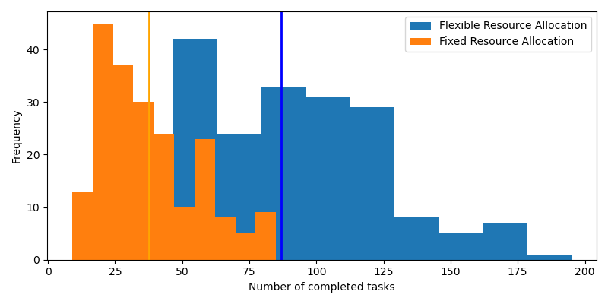
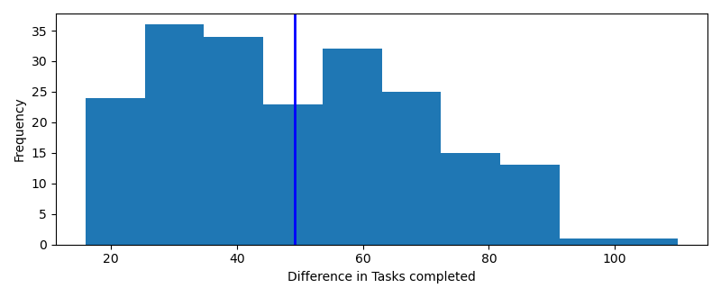
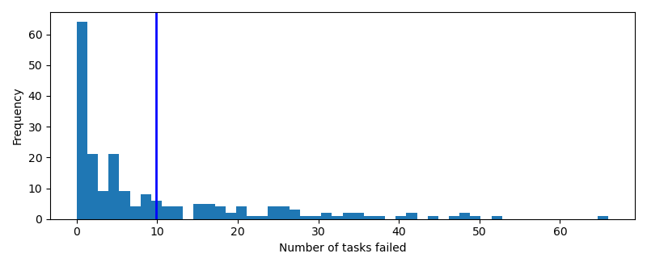
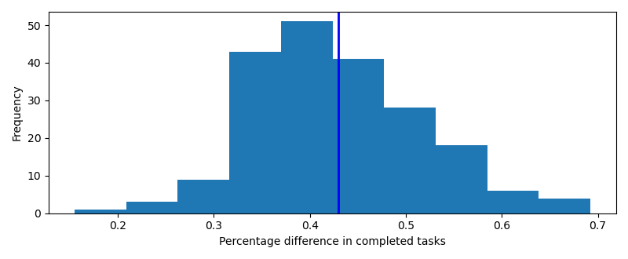
Fixed vs Flexible Resource allocation
An implementation of a Fixed resource allocation agent was implemented to compare results
Flexible resource allocation mechanisms were found to allocate almost twice as many completed tasks as fixed however was found to also fail around 5% of tasks.
A full discussion of these results can be found in Subsection 5.2.1

Slide 8
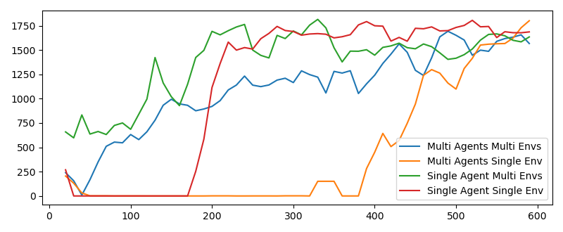
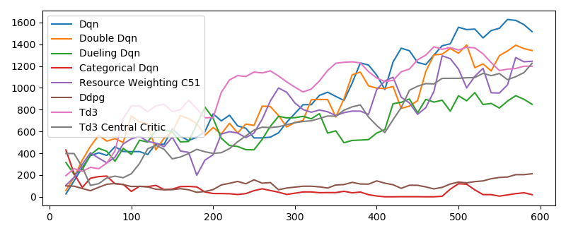
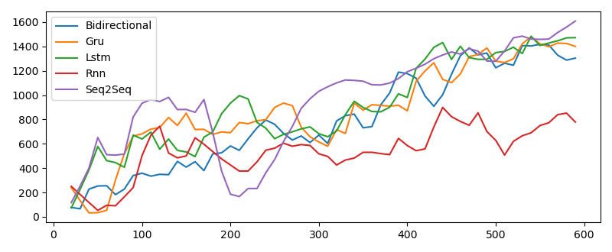
Comparison of Various Server Agents
Due to the exploratory nature of the project, a large number of different server agents were implemented to compare different algorithms, network architectures and hyperparameters
A full analyse of these agents can be found in the following subsections: 5.2.2 for hyperparameters, 5.2.3 for Reinforcement learning algorithms and 5.2.4 for Network architectures

Slide 9
Conclusion
The aim of this project was to expand previous research to fix flaws in the Flexible resource allocation optimisation problems for Mobile Edge Computing.
This was achieved by introducing the notion of time into the optimisation model. With
Reinforcement Learning agents applied to solve the new problem and learn the optimal strategy for both auction bidding and resource allocation.
While agents were found to efficiently learn the policy achieving significantly more tasks completed than the standard fixed resource allocation mechanisms used in most systems.
However 7% of all tasks were not completed within their deadline meaning overall the problem is a large improvement current methods.
More research and analysis of agents are required before such systems can be implemented into real-life systems.

Slide 10
Future works
More training time for all agents
To improve the results of agents, several heuristic are suggested to be implemented
N-step rewards (Sutton, 1988)
Distributed Distributional Ddpg agents (Barth-Maron et al., 2018)
Mixed competitive-cooperative centralised critic for Ddpg (Lowe et al., 2017)
Quantile regression Dqn (Dabney et al., 2018a)
Risk sensitive Dqn (IQN) (Dabney et al., 2018b)
Improvements to the optimisation problems for
Computational algorithms are not linearly scalable
Users have limited bandwidth resources

